Slide 1
Huffman Encoding
Based on Hardware

Slide 2
Outline
Motivation
Introduction
Encoder Implementation
Algorithmic State Machine
Software to Hardware Conversion
Results

Slide 3

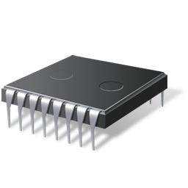



Motivation
Zip(Deflate) compression is widely used!
The Zip hardware implementation is quite promising
Less traffic means
Less Power Consumption
ZIP
More storage with
No Extra Cost
Fast enough for real-time processing
Wireless
Storage

Slide 4
Motivation
Zip Encoder Workflow
Input
LZ77
Huffman
Output
Raw Data
Merge the duplicated Strings
Tree_Sorter
Tree_Constructor
Tree_Encoder
Compressed Data

Slide 5
Introduction
Build a Huffman Tree
1. Find two nodes with minimum weights
2. Add these two weights, the result of which is inserted into table as a new node. And then remove the previous two nodes
3. Go to step 1, until there is only one node in the table
Char | Weight
a | 1
c | 3
g | 2
d | 5
m | 4
… | 0
… | 0
Char | Weight
c | 3
d | 5
m | 4
(a, g) | 3
… | 0
Huffman Tree
Text Input
3
a
2
g
1

Slide 6
Introduction
Huffman Encoding
Encoding Procedure
From up to down, Left node is marked as ‘0’, and Right node is marked as ‘1’
The encoded data cannot be the prefix of the other encoded data.
Char | Weight
a | 1
c | 3
g | 2
d | 5
m | 4
… | 0
… | 0
15
0
1
Char | Weight
a | 000
c | 01
g | 001
d | 11
m | 10
6
10
1
0
1
0
3
c
3
m
4
d
5
0
1
1000001
3*8bits -> 7 bits
Save 17 bits!!
m a c
a
2
g
1
g: 001

Slide 7
Implementation
Design Methodology
Software Simulation
Simulate the algorithm in C language/ Pseudo code. Thinking in a “Hardware” way.
Algorithmic State Machine Design
Apply the ASM design methodology to convert the algorithm to hardware.
Hardware Implementation
Implement the designed RTL architecture from the previous step in HDL. And then verify the hardware module(s).

Slide 8
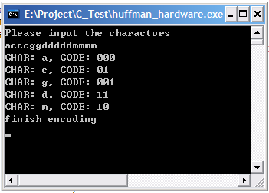
Software Simulation
Design Methodology
IDE: Dev C++ Compiler: gcc
Tree_Constructor: Build the Huffman tree from heap by calling Tree_Sorter
Tree_Sorter: Return two nodes with the minimum weights
Tree_Encoder: Encode the Huffman tree to binary code
Key Components
Tree_Constructor
Code_Dumper
Tree_Sorter
Main
State Machine Controller
Tree_Encoder

Slide 9
ASM
Design Methodology
Convert the pseudo code into an ASM chart
 Create a data path based on the ASM chart
 Design the control logic based on the detailed ASM chart
Array Transformation
Code_RAM
Tree_RAM
Address | Char[7:0] | Weight[7:0] | HuffmanCode[7:0]
0 | ‘a’ | 1 | 0
Address | Weight[7:0] | LC[7:0] | RC[7:0] | Parent[8:0]
0 | 3 | 1 | 2 | -1
Let’s take Tree_Sorter as an example.

Slide 10
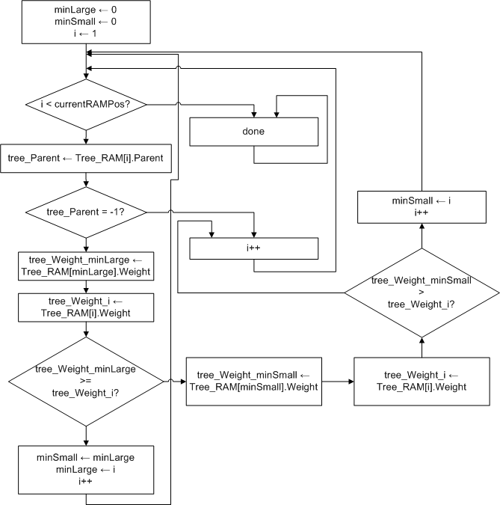
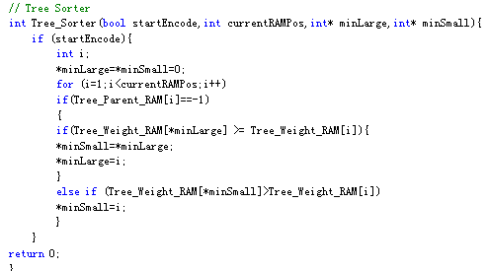
Hardware Implementation
ASM Chart
Convert the code into an ASM chart

Slide 11
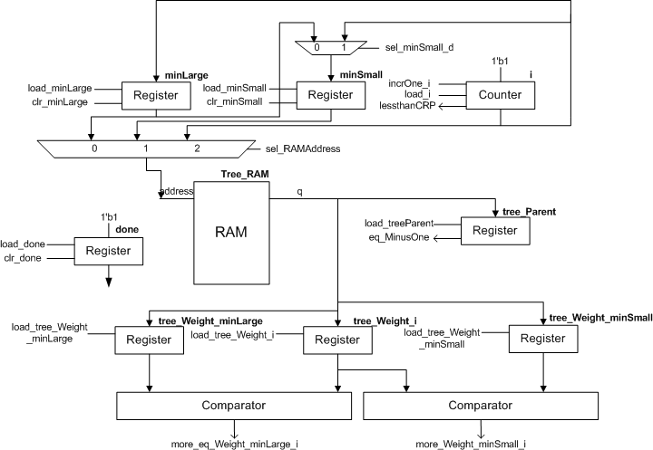
Hardware Implementation
Datapath
Create a data path based on the ASM chart

Slide 12
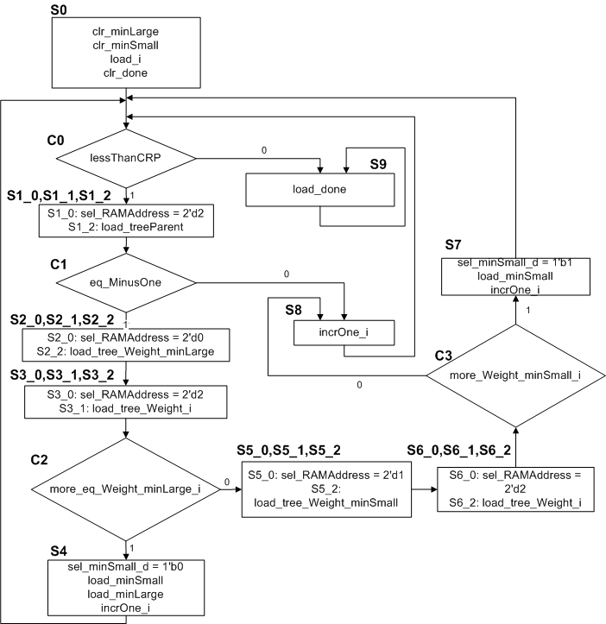
Hardware Implementation
Control Logic
Design the control logic based on the detailed ASM chart

Slide 13
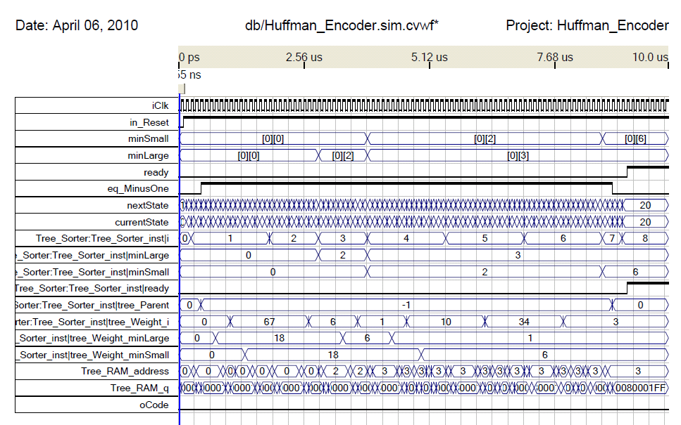
Hardware Implementation
Verification
Tree_RAM
Address | Weight | LC | RC | Parent
0 | 18 | -1 | -1 | -1
1 | 67 | -1 | -1 | -1
2 | 6 | -1 | -1 | -1
3 | 1 | -1 | -1 | -1
4 | 10 | -1 | -1 | -1
5 | 34 | -1 | -1 | -1
6 | 3 | -1 | -1 | -1

Slide 14
Results
ASM Design
Tree_Constructor, Tree_Sorter, and Tree_Encoder
Hardware Implementation
Tree_Sorter
Synthesis Result
Tree_Sorter (Quartus 8.0), Altera Stratix II Board
Name | Number
Combinational ALUTS | 78/12,480
Dedicated Logic registers | 66/12,480
Total block memory bits | 17920/419,328

Slide 15
Thank You!
Any Questions?

